Slide 1
Segmenting and Distinguishing Pericyte and Smooth Muscle Cells in Microscopy Images using Deep Learning
By Tyler Ruch

Slide 2
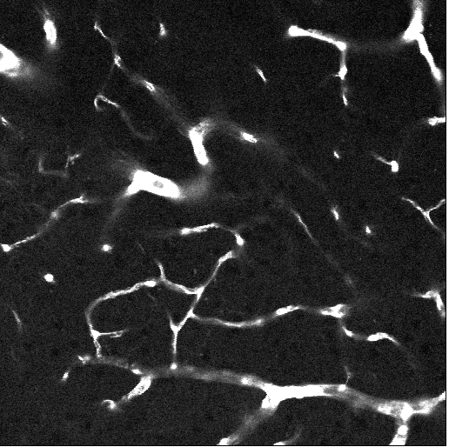
Introduction
Task: Identify and classify two different types of cells in microscopy images
Challenge: Small but representative dataset; automated methods are limited in terms of distinguishing between cell types
Solution? Use CNNS

Slide 3
Limited Data
Issue: CNNS are not able to readily learn from a dataset of 100 images
Common solutions:
Augmentation
automated artificial data generation
My Dataset: 125 (512x512 pixel) images, 2 sets of cell masks of expert-generated ground truth that provide a representation of many regions of the brain
25 images randomly held out for test set
100 images remain for training and validation set

Slide 4
Imbalanced data
Total non-cell pixels in training + valid data: | 26365757
Total cell pixels in training + valid data: | 110787
total pixels pericyte: | 69342
total pixels smooth: | 41445
Thus, 99.5% of the pixels in the data do not contain cells. This means using a traditional machine learning classifier for this data would output no cells, and result in 99.5% accuracy!
Of the pixels that contain cells, ~65% are one cell type, the rest are the other
Luckily, many machine learning tasks contain imbalanced data such as this, and this imbalance occurs often in data science
For example, a common example is dataset that may exist with many medical parameters with the output being whether or not the patient had brain cancer
However, unlike this type of medical data, it is not beneficial to err towards false positives and against false negatives, but to instead be as accurate as possible in general

Slide 5
My data strategy
Adopted from [2] and [1], I aim to solve the limited and imbalanced data problem simultaneously
Idea: [2] use all binary classifications. Let the data be 65x65 images where the classification is whether or not the center pixel contains the feature to learn
Idea: [1] create an artificially balanced dataset by generating an image from each pixel containing a cell and randomly generating the same amount of images with center pixels not containing a cell
Numbers: 97,500 images of cells, same number with no cells, in training set
13,200 images of cells, same number with no cells, in validation set

Slide 6
My data strategy
This strategy was used to create datasets for two binary classifiers:
Does the central pixel contain a cell or not? (100,000 images of each class)
Is the pixel in the center a pericyte or smooth muscle cell? (40,000 images of each class) (limited by the lower number of smooth muscle pixel images)
Thus, I now have two fairly large binary datasets that are artificially balanced
Note: As described in [2], for generation of images where the 65x65 window extends over the edge of the image, the image was mirrored to extrapolate beyond the edge.

Slide 7
Deep Learning - strategy
Idea: train the binary classifiers as described, which will lead to a model that outputs 50% one class and 50% another, as it is taught. This is not wanted, however.
Solution: use thresholding to push the classes towards the desired ratio
Many strategies exist for generating these thresholds, as described in [1] and [2].
One clear method is to use the ratio of these features in the training and validation sets to create the thresholds to be used on the test set.

Slide 8
Deep learning - model
Both models run for 10 epochs and evaluated on training and validation set binary accuracy
Each epoch exposes the network to each image in the training set, and evaluates the network on the entire validation set
The model uses max pooling to downsample and dropout to avoid overfitting [4],[2]
Specific Model Structure:
3x3 2D convolution, RELU activation function, followed by 2x2 Max Pooling (32 filters)
3x3 2D convolution, RELU activation function, followed by 2x2 Max Pooling (32 filters)
3x3 2D convolution, RELU activation function, followed by 2x2 Max Pooling (64 filters)
Flatten to 1 Dimension
Dense layer, RELU activation (64 filters)
0.5 Dropout
Dense layer, Sigmoid activation
Loss function: Binary Crossentropy

Slide 9
Deep learning - thresholds
Cell locator threshold:
Total non-cell pixels in training + valid data: | 26365757
Total cell pixels in training + valid data: | 110787
threshold for having cell: | 0.004184345
Cell distinguisher threshold:
total pixels pericyte: | 69342
total pixels smooth: | 41445
threshold for pericyte: | 0.625903761
Pixel counts obtained from training and validation original 512x512 images
Threshold applied to output of binary classifier, which is as follows:
0: has cell, 1: no cell
0: pericyte, 1: smooth muscle cell

Slide 10
Results of training
Accuracy percentages of each network on the validation set:
Cell vs no cell classifier: 98.5% accuracy
Cell distinguisher (pericyte vs smooth muscle) : 90% accuracy

Slide 11
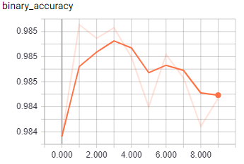
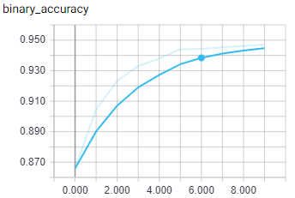
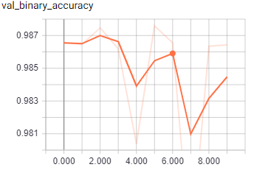
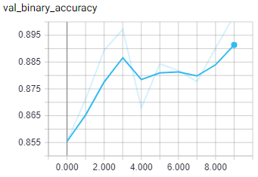
Cell VS No Cell:
Pericyte VS Smooth Muscle Cell:
Training:
Validation:
Note: The weights ultimately used were those with the highest validation set accuracy

Slide 12
results – Cell/no-cell deep learning versus automated
Strategies in [3], specifically blurring, Otsu thresholding, and connected pixels with a size 10-250, used for the automated cellular feature detection
For accuracy evaluation, various error metrics including F-score were used
In addition, a custom F-score function was used which calculates sensitivity and specificity by a blob-by-blob basis instead of a cell-by-cell basis, so that a cellular feature was considered “detected” as long as it overlapped one in the ground truth
 | MSE | SSIM | NRMSE | F-Score | Custom F-Score
CNN | 266.148468 | 0.981571708 | 0.893396736 | 0.598400381 | 0.7204409
Otsu+CC | 492.6187477 | 0.961783731 | 0.803244021 | 0.567758471 | 0.61855112

Slide 13
Results – putting it all together
For a full classification, it is necessary to run the cell/no cell classifier first, and then identify the type of cell if necessary with the cell distinguishing classifier
Confusion matrix:

Slide 14
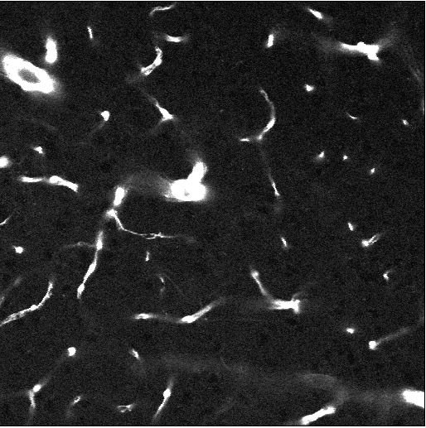
Results – putting it all together
Key:
Green: Correctly identified Pericyte
Blue: Correctly identified Smooth Muscle
White: Correctly identified no cell
Red: Pericyte classified as Smooth Muscle Orange: Smooth Muscle classified as Pericyte
Purple: Pericyte identified as no cell
Brown: Smooth Muscle identified as no cell
Yellow: No cell identified as Pericyte
Black: No cell identified as Smooth Muscle

Slide 15
Key:
Green: Correctly identified Pericyte
Blue: Correctly identified Smooth Muscle
White: Correctly identified no cell
Red: Pericyte classified as Smooth Muscle
Orange: Smooth Muscle classified as Pericyte
Purple: Pericyte identified as no cell
Brown: Smooth Muscle identified as no cell
Yellow: No cell identified as Pericyte
Black: No cell identified as Smooth Muscle

Slide 16
Implications of results
Smooth muscle cells, due to their large size and odd shape, seem to be most commonly misidentified as no cell
It seems most difficult for the models to learn to identify and label pericytes; however, many of the confusion images seem to have many correctly identified pericytes. Perhaps the model is not correctly identifying shapes of the pericytes as they are given in the masks, but is identifying the locations
The models are identifying whether or not there is a cell with quite a lot of success

Slide 17
Future works and parting thoughts
Data augmentation in the cell distinguisher to increase the accuracy
More sophisticated threshold detection
More data / better data

Slide 18
References
[1] B. Krawczyk, “Learning from imbalanced data: open challenges and future directions,” Progress in Artificial Intelligence, vol. 5, no. 4, pp. 221–232, Nov. 2016.
[2] D. C. Ciresan, L. M. Gambardella, and A. Giusti, “Deep Neural Networks Segment Neuronal Membranes in Electron Microscopy Images,” p. 9.
[3] N. Sharma, A. Ray, K. Shukla, S. Sharma, S. Pradhan, A. Srivastva, and L. Aggarwal, “Automated medical image segmentation techniques,” Journal of Medical Physics, vol. 35, no. 1, p. 3, 2010.
[4] O. Ronneberger, Invited Talk: U-Net Convolutional Networks for Biomedical Image Segmentation, Informatik aktuell Bildverarbeitung fr die Medizin 2017, pp. 33, 2017.

